Slide 1
Akash Kumar
Final Proposal
Wearables

Slide 2
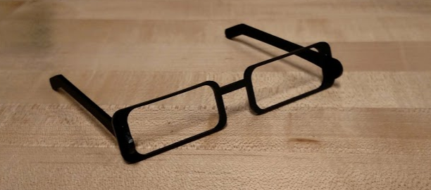
Why not scale the prototype
Where I began
Smart glasses
Motivation
Already on my face
Lots of area
Proximity to body
Lots of interactions
Problems
Bulky
Batteries
Feedback

Slide 3
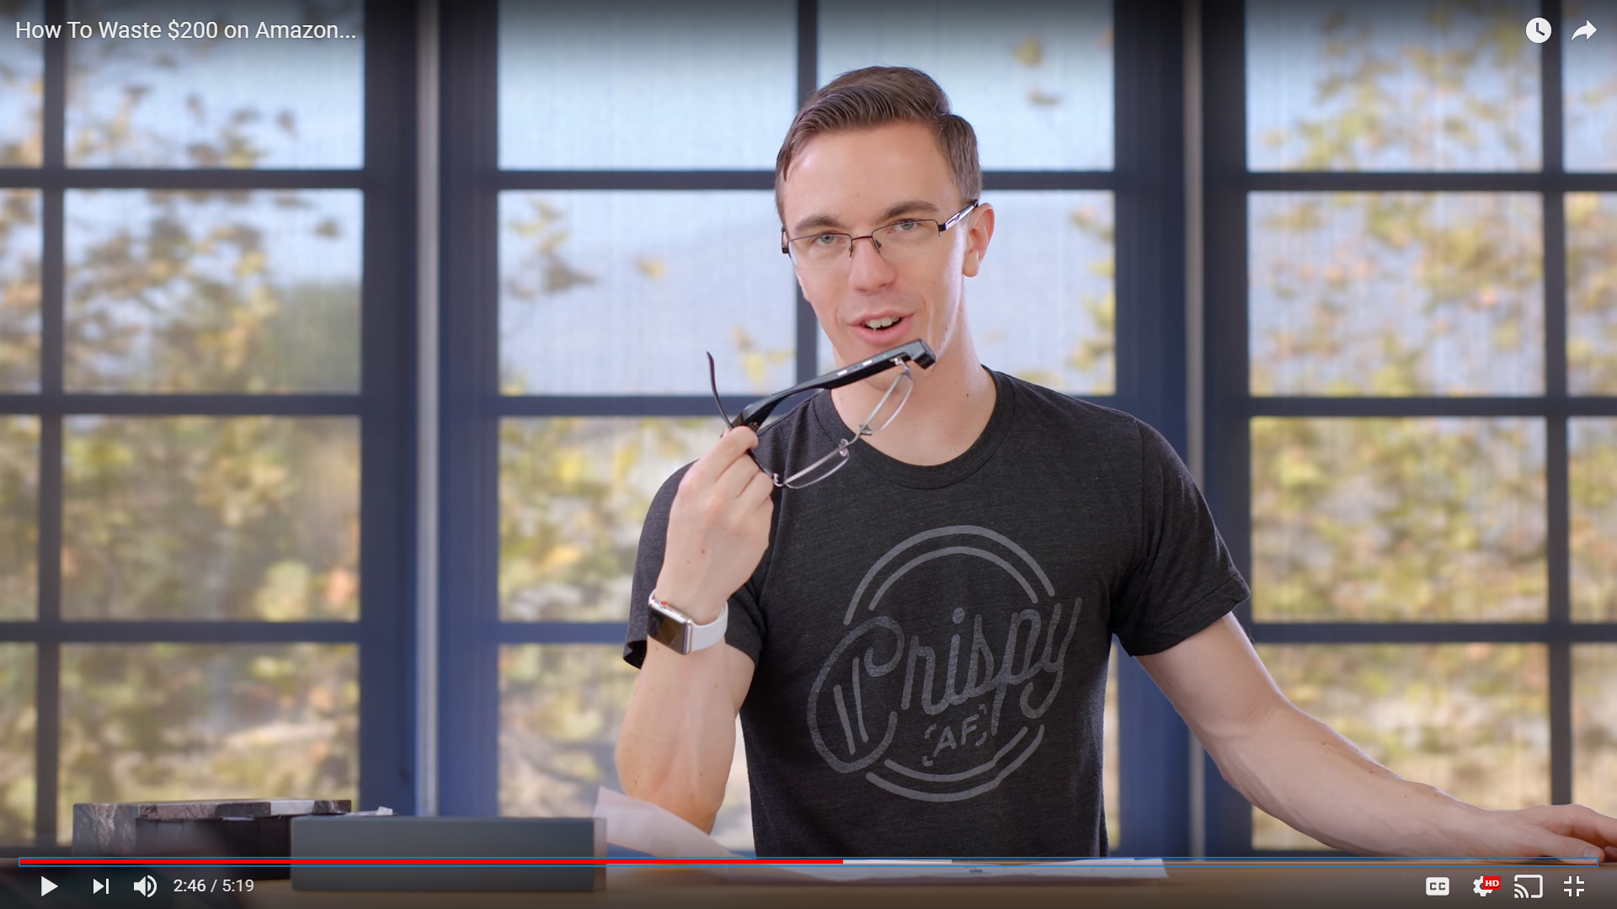
Seeing it in the wild

Slide 4
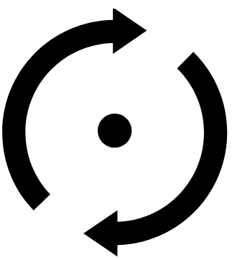
A pivot
Sensors away from the body
New interactions
Wider audience
More flexibility
More interactive
Different part of the body
Different use case
Better reasoning

Slide 5


The idea
A smart glove with sensors “at your fingertips”
Each finger can have a unique use
Device consolidation
Combining multiple streams of data
Accurate information
Less detailed display, same outcome
Initial Sensor considerations
Pressure
Heart rate
Temperature
Sweat

Slide 6
Audience
Who:
Parents
Data Freaks
Haters of one use devices
Where
At home
How
Pressure sensor activates device, reading are displayed on back of hand
Why
More frequent data collection

Slide 7
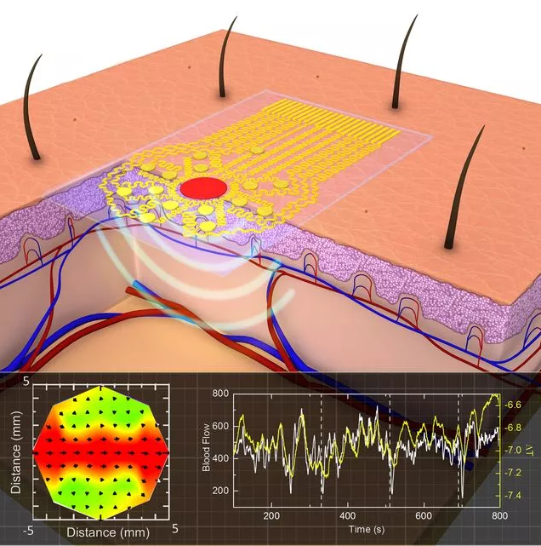
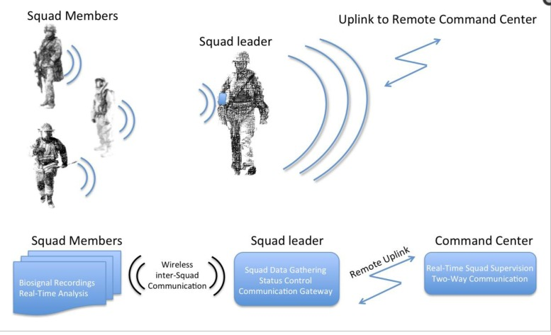
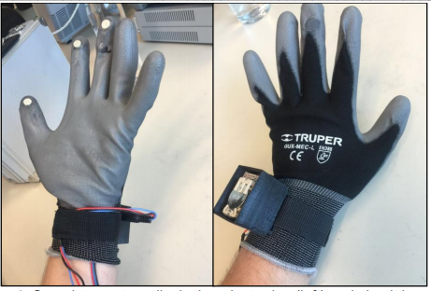
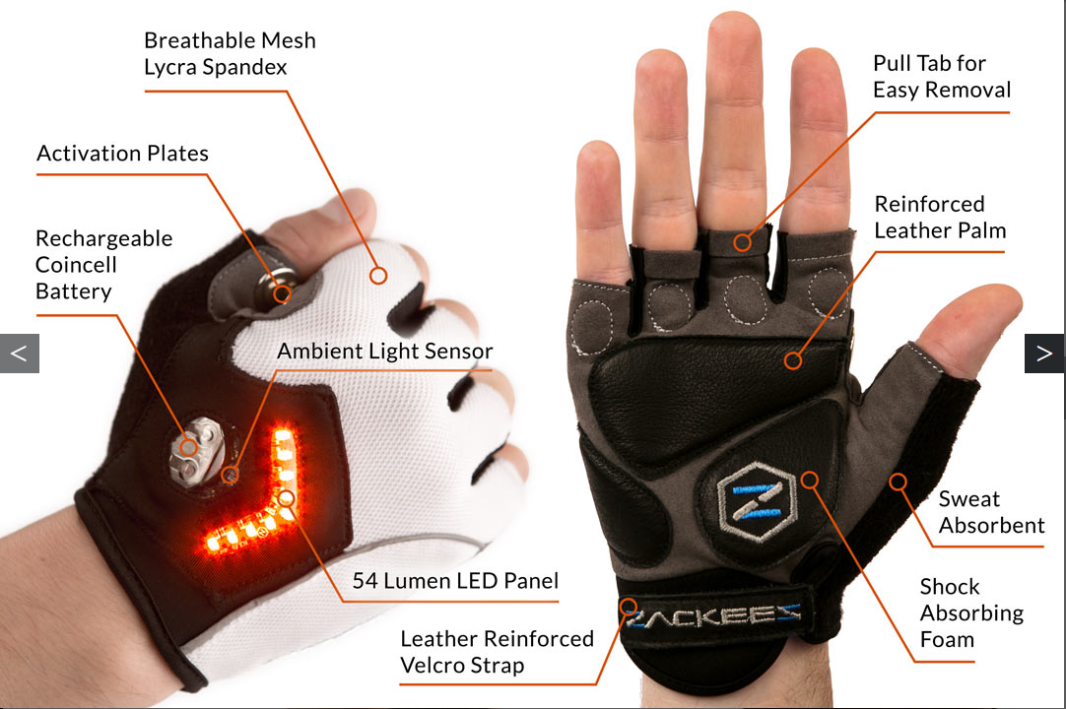
Competition

Slide 8
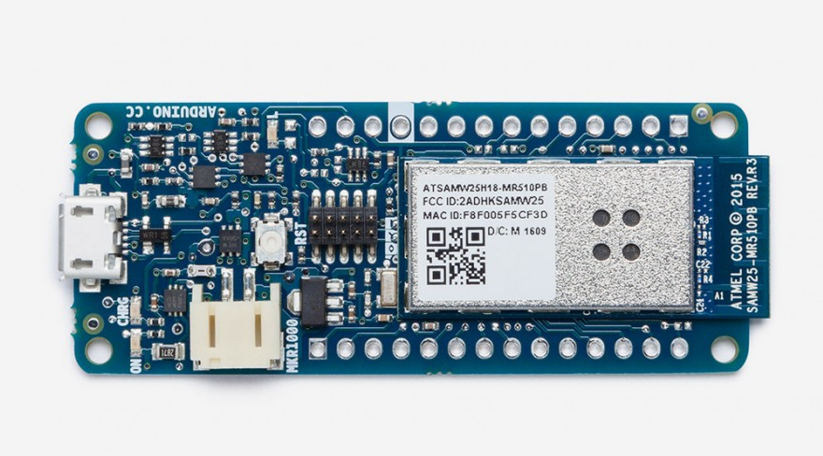
Build
Sturdy glove
Conductive thread
Wires
A well suited microcontroller
Sensors
Pressure
Touch
Heart rate
Galvanic skin response
Temperature
Force

Slide 9
User Testing
Three Kinds
Feedback
Draw out interfaces that will be presented, find the best way to displaying the data
Intuitive
Present the prototype and see if it clicks, Will the activation method be easy?
Usability
Are these the best sensors? Survey people about the data they think is just under the surface.

Slide 10
Timeframe
11/2: Complete Initial User testing for usability
11/6: Create initial parts list and start to produce
11/9: Conduct feedback user research bases on finalized hardware
11/14: Assemble Prototype
11/16: Conduct Intuitive User testing on Prototype
11/30: Work on software
12/7: Polish prototype
12/10: Run around fixing everything I forgot
12/14: Present Product

Slide 11
Bibliography
Love, LeAnn M., and Teresa Walker. "Gender Differences in Diagnosis and Treatment in Acute Coronary Syndrome." (2006).
Mitten: Jae Deasigner, Image
Ossola, Alexandra. "This Flexible Sensor Sticks To Your Skin And Measures Your Blood Flow." Popular Science. University of Illinois at Urbana-Champaign, 30 Oct. 2015. Web.
Rotate: Joshua Weber, Image
Seoane, Fernando, Inmaculada Mohino-Herranz, Javier Ferreira, Lorena Alvarez, Ruben Buendia, David Ayllón, Cosme Llerena, and Roberto14 Gil-Pita. "Wearable Biomedical Measurement Systems for Assessment of Mental Stress of Combatants in Real Time." Sensors (Basel, Switzerland). MDPI, 14 Apr. 2014. Web.
How to Waste $200 on Amazon, Austin Evans, 21 Oct, 2017. https://www.youtube.com/watch?v=L87l9-2B0ug
https://zackees.com/product/pre-order-zackees-turn-signal-gloves/
Other assets created by me or extracted from the documented sources above.

